Slide 1

Electrical Machinery Fundamentals
EE 250 SPRING 2020
Lecture 10-Chapter 18
1

Slide 2
Chapter 18 Single-Phase Motors

Slide 3
18.1 Construction of a single-phase induction motor
Similar to that of 3-phase induction motor
Composed of squirrel-cage rotor and stator carries main windings and smaller auxiliary winding
Main winding: Creates set of N and S poles
Smaller auxiliary winding: Operates during short period of time when motor starts up and have same number of poles as the main winding have
Construction is shown step by step in images:

Slide 4
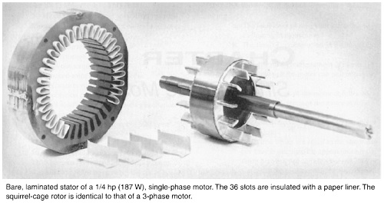
18.1 Construction of a single-phase induction motor

Slide 5
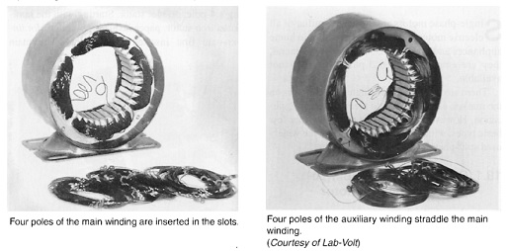
18.1 Construction of a single-phase induction motor

Slide 6
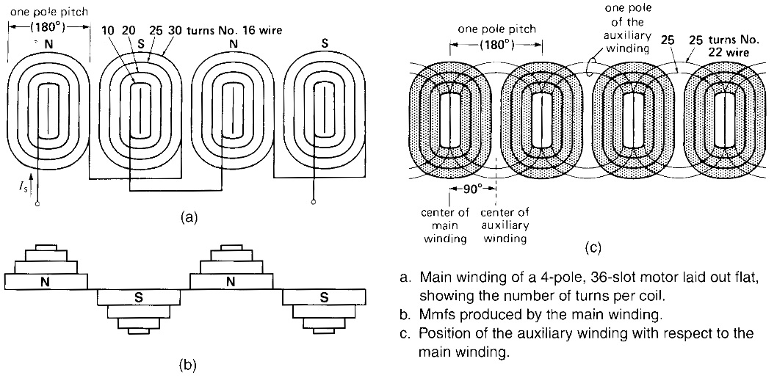
18.1 Construction of a single-phase induction motor

Slide 7
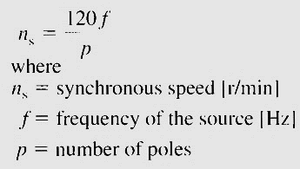
18.2 Synchronous speed

Slide 8
18.3 Torque-speed characteristic
Schematic diagram of rotor and main winding of a 2-pole induction motor is shown:
On application of AC voltage, flux is produced but it pulsates back and forth and no rotation is produced like 3-phase induction motor
Initial external spin is required in either direction for rotation
Motor develops powerful torque as it approaches the synchronous speed

Slide 9
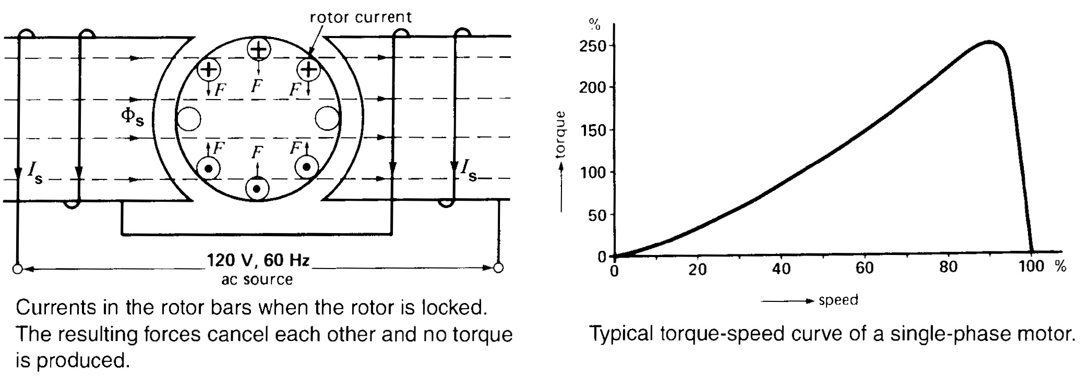
18.3 Torque-speed characteristic

Slide 10
18.4 Principle of operation
Complex and can be explained by cross-field theory
As rotor begins to turn, emf E is induced in rotor as they cut the stator flux ɸ_{S}
Voltage increases as the rotor speed increases => Current I_{r} flows in rotor bars => Rotor flux ɸ_{r} will be produced that will act perpendicular to stator flux ɸ_{S}
ɸ_{r} will not reach at its maximum value in the same time as ɸ_{S} does => ɸ_{r} lags behind ɸ_{S} by 90°
Combined action of both fluxes produces revolving magnetic field => Similar to 3-phase
ɸ_{r} increases as motor speeds up becoming almost equal to ɸ_{S} at synchronous speed
Flux is strong horizontally and weak vertically => Field strength at low speed follows elliptic pattern
As motor approaches synchronous speed => ɸ_{r} becomes almost equal to ɸ_{S} => Nearly perfect revolving field is produced

Slide 11
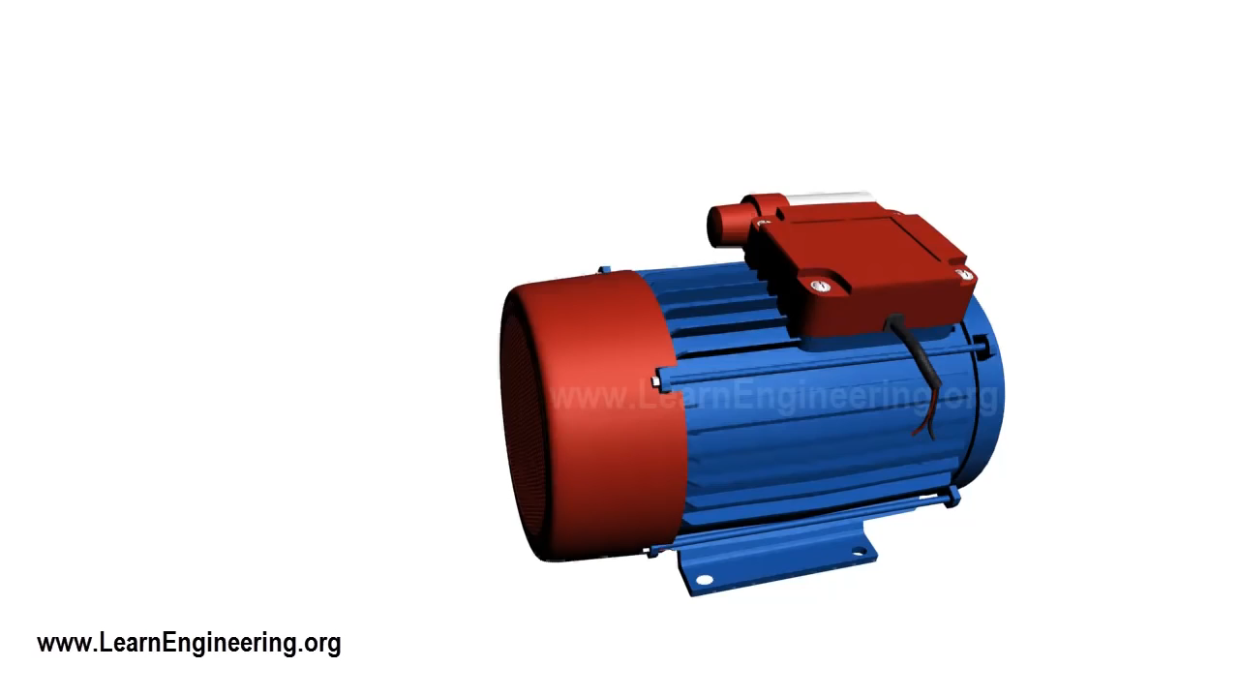

Slide 12
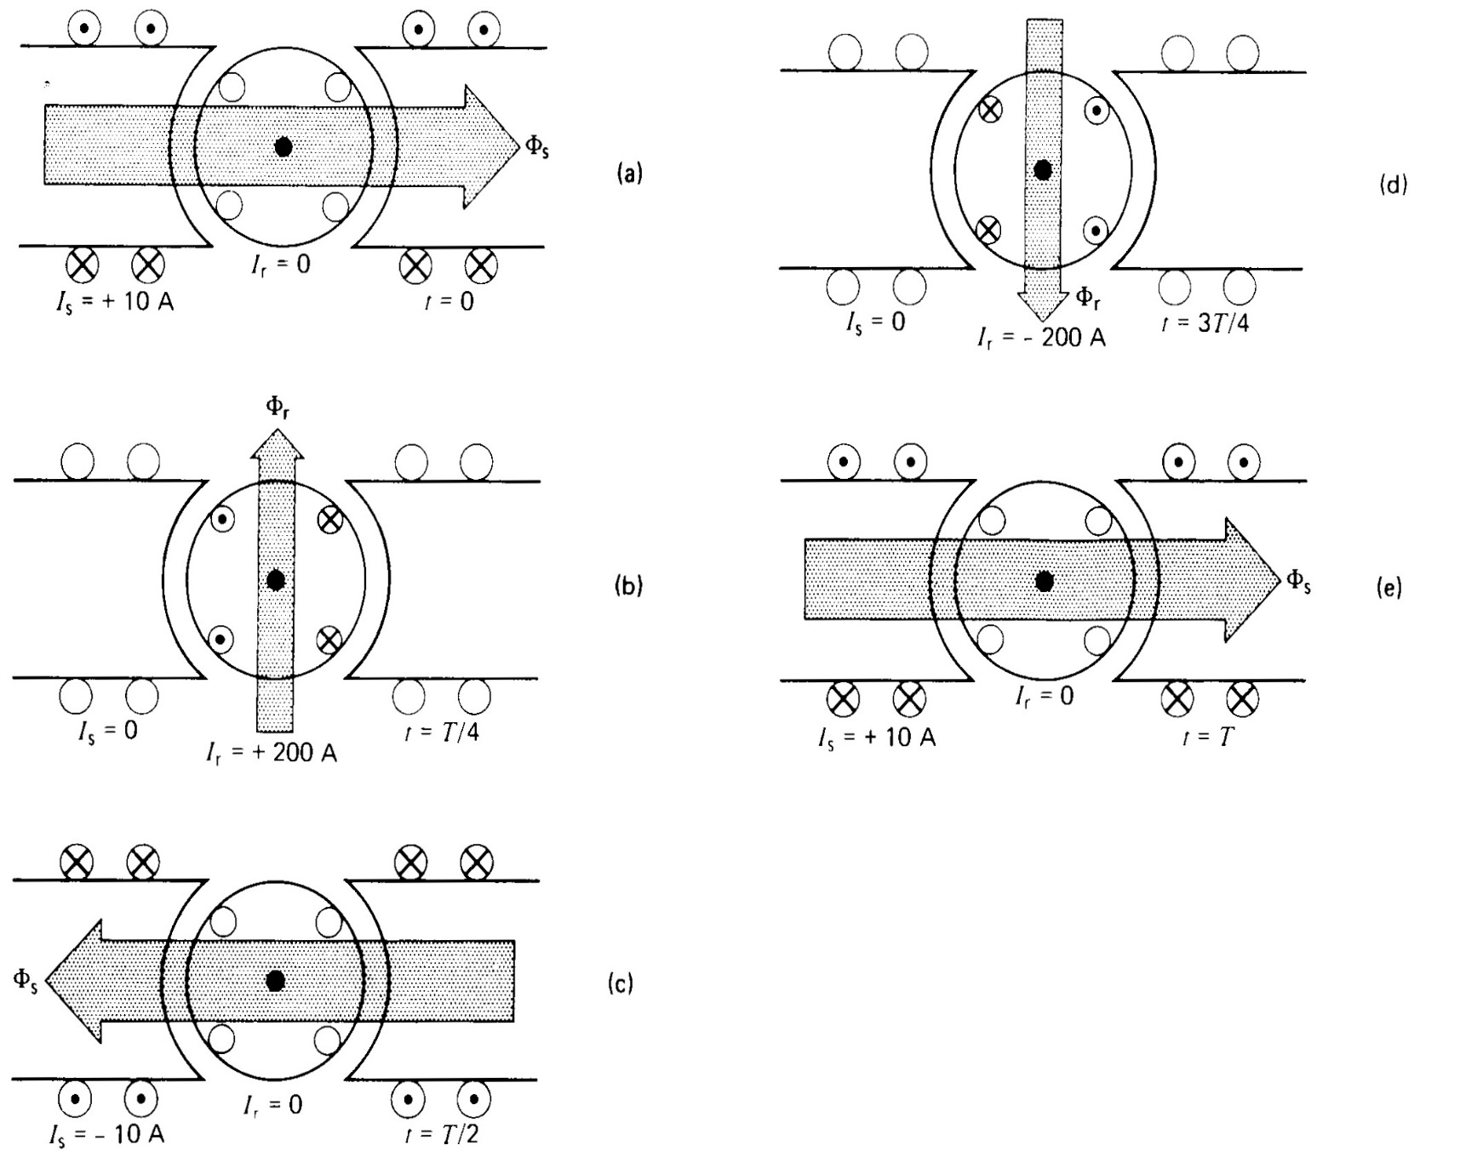
18.4 Principle of operation

Slide 13
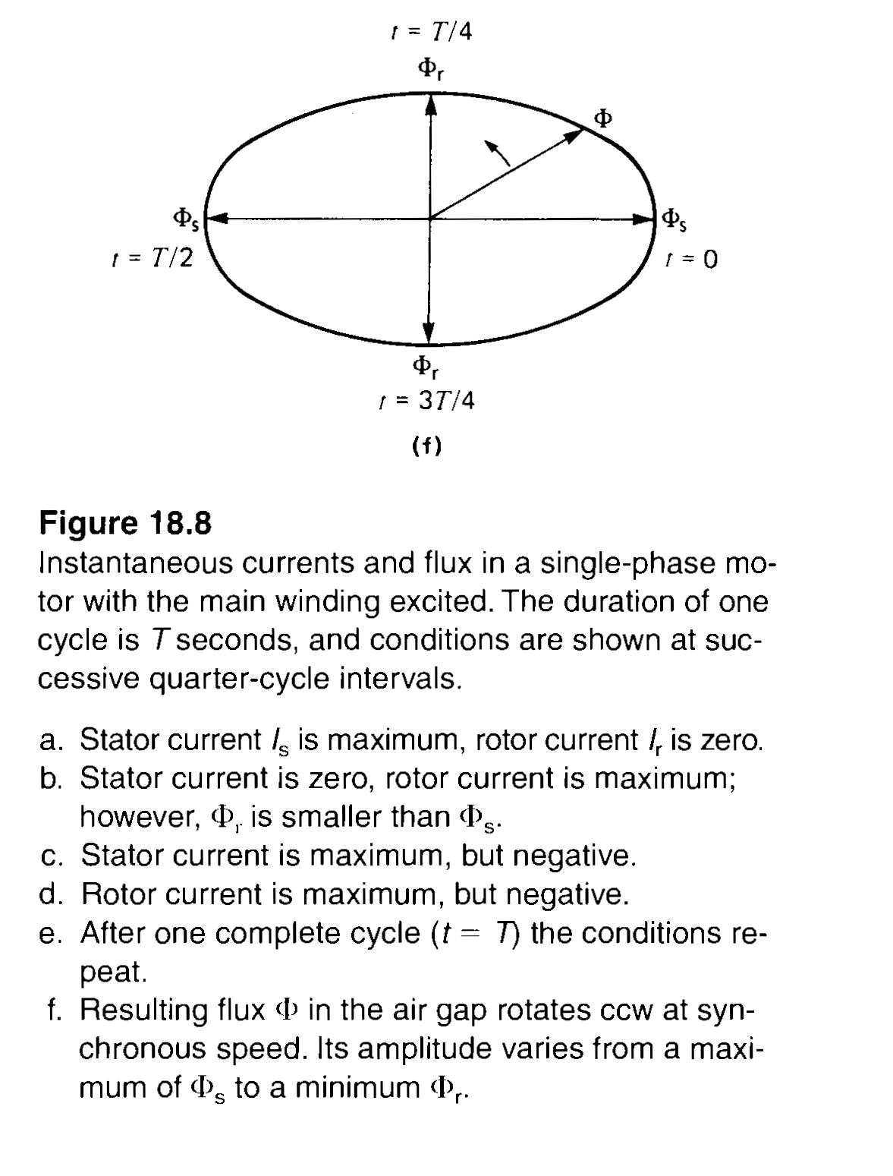
18.4 Principle of operation

Slide 14
18.5 Locked-rotor torque
Creation of revolving magnetic field by the addition of an auxiliary winding
Explanation of figure:
Connect main and auxiliary winding to AC source => Main and auxiliary windings produces ɸ_{S} and ɸ_{a} respectively, If 2 fluxes are out of phase then revolving magnetic field is set up
Either of flux can lead or lag depending upon the setup
Auxiliary winding is used to produce strong flux ɸ_{a} during accelerating period when rotor flux ɸ_{r} is weak => ɸ_{a} strengthens ɸ_{r} and produces powerful torque both at standstill and low speeds, Locked rotor torque is given as:
T= k*I_{a}*I_{s}*sinα
Impedance in series with auxiliary winding for required phase shift between I_{a} and I_{s}
Impedance can be capacitive or inductive depending upon the required starting torque
Special centrifugal switch in series with auxiliary winding => Designed to disconnect auxiliary when motor reaches 75% of synchronous speed

Slide 15
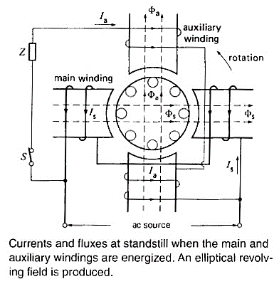
18.5 Locked-rotor torque

Slide 16
18.6 Resistance split-phase motor
Main winding (having large number of turns) of 1-phase motor is usually made of large wire to reduce I²R losses , Main winding will be more inductive than Resistive
the inductive reactance is high and resistance is low => Locked-rotor current I_{s} lags behind the applied voltage
Auxiliry winding is made of small wire and less number of turns and will be more resistive.
Ia will be more nearly in phase with E
In resistance split-phase motor
The resulting phase angle α between I_{a} and I_{s} produces starting torque.
Line current I_{L} is equal to phasor sum of I_{a} and I_{s ,} I_{L} is 6 to 7 times the nominal full load current of rotor at start.
Due to small wire usage for auxiliary winding, current density is high and winding heats up very quickly
So, starting period must be limited in order to avoid winding burning or motor must be used with thermal relay

Slide 17
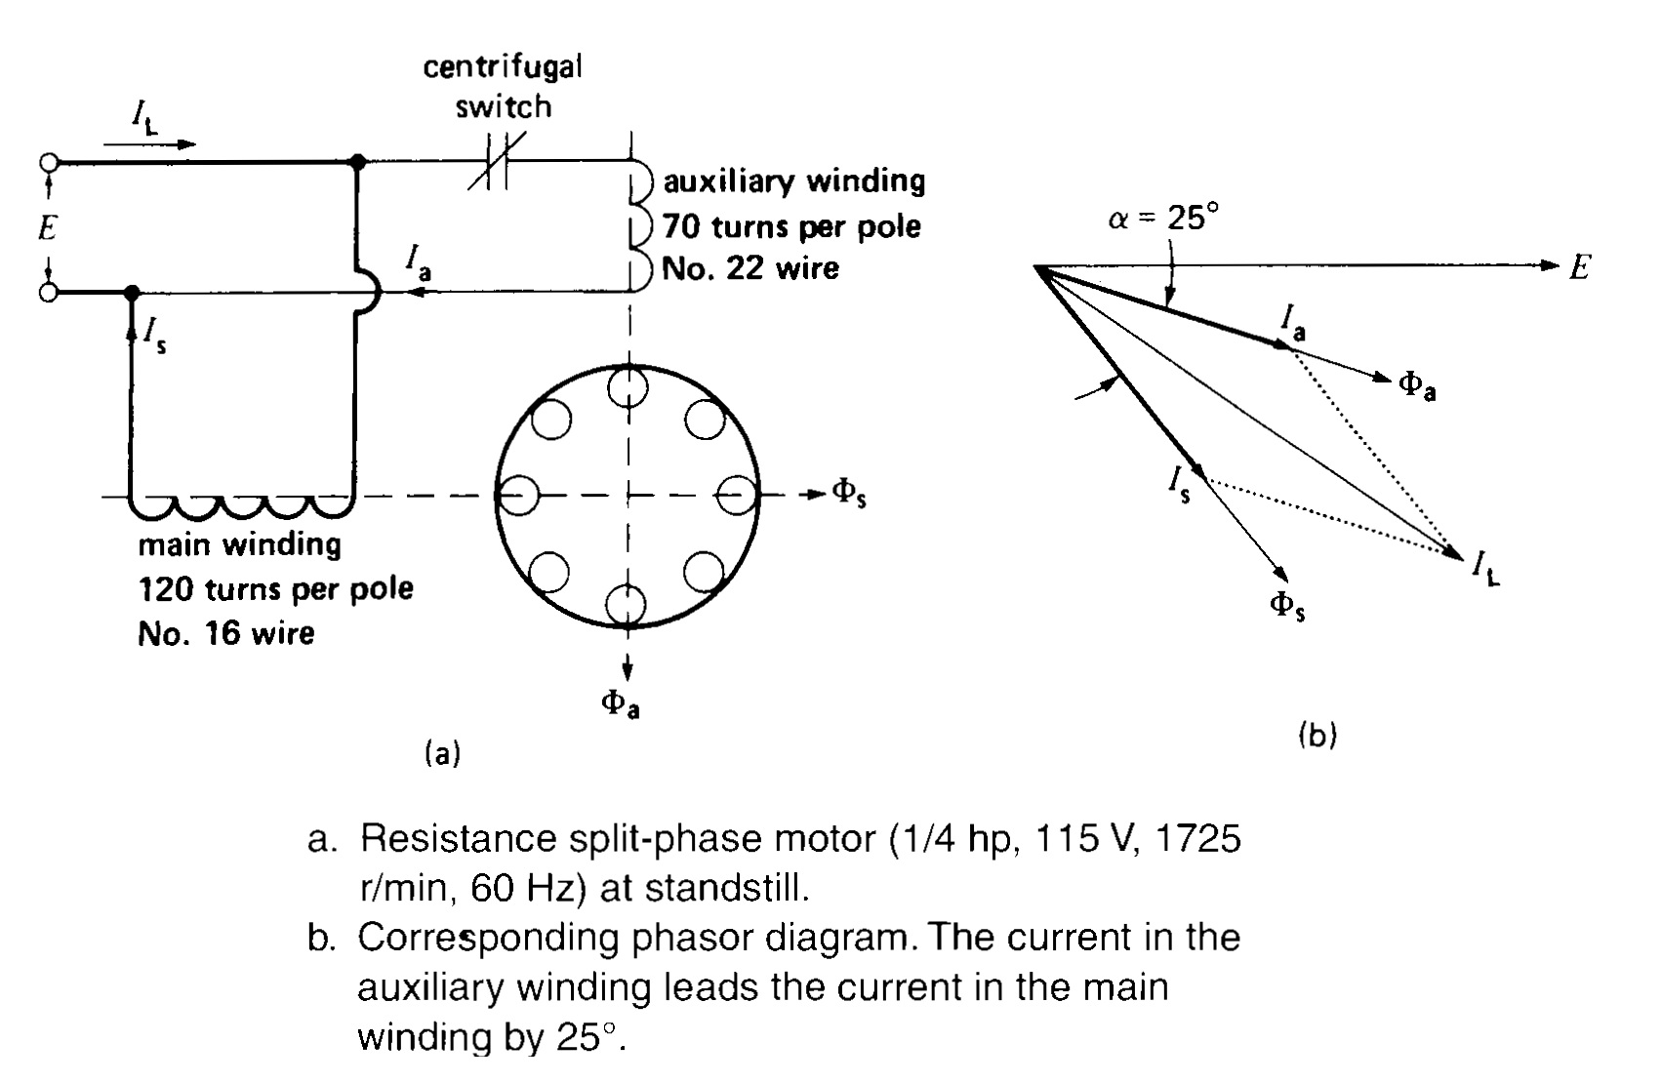
18.6 Resistance split-phase motor

Slide 18
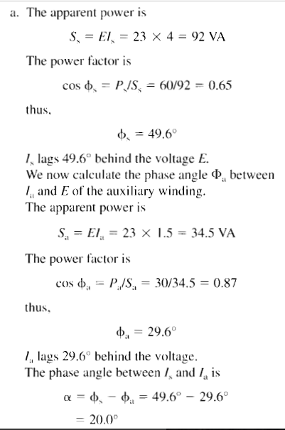

Slide 19
18.7 Capacitor-start motor
Identical to split-phase motor with same number of turns of auxiliary windings as that of main winding
Capacitor and centrifugal switch are connected in series with auxiliary windings
Capacitor is used to produces greater phase shift between I_{a} and I_{s} provided I_{a} leads I_{s}
This approach reduces starting current in auxiliary winding for same starting torque as compared to split-phase motor => Less heat up => Smaller line current I_{L}
Due to high starting torque and low I_{a} , capacitor start motors are preferred for application involving frequent and prolong starting periods
I_{L} is 4 to 5 times the nominal current of rotor at start.
Better starting characteristics than that of split-phase motor
Capacitor-start motors are used when high starting torque is required

Slide 20
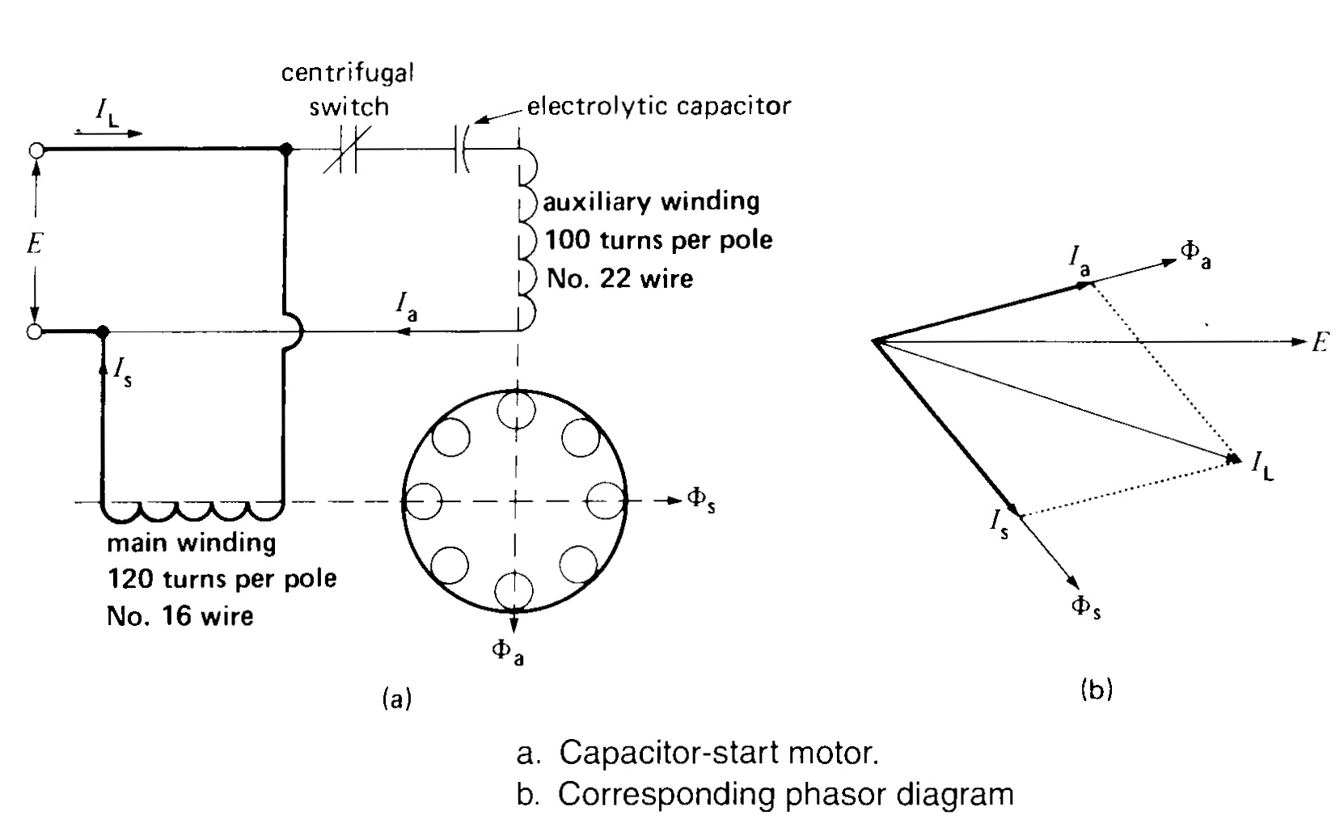
18.7 Capacitor-start motor

Slide 21
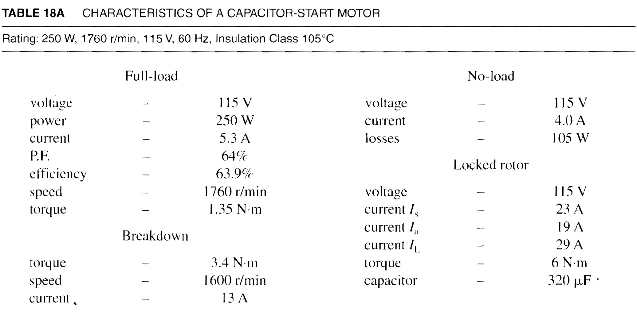
18.7 Capacitor-start motor

Slide 22
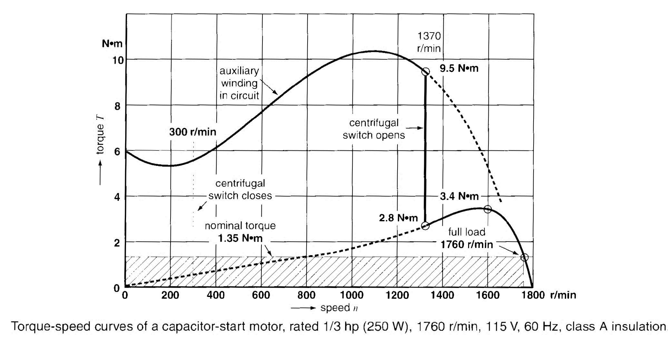
18.7 Capacitor-start motor

Slide 23
18.8 Efficiency and power factor of single-phase motors
Efficiency and power factor of fractional horse-power single-phase induction motor are usually low
Low power factor is mainly due to large magnetizing current that ranges between 70% to 90% of full-load current
These motor at no-load have substantial temperature rises
Integral horsepower single-phase motors can have efficiencies and power factors above 80%

Slide 24
18.10 Capacitor-run motor
Capacitor-run motor is 2-phase motor that receives its power from single-phase source
Construction:
Consist of two windings
One is directly connected to source
Other winding is also connected to source but in series with capacitor
Capacitor-fed winding has large number of turns of relatively small wire as compared to directly connected wire
Application:
Due to its quiet nature (2-phase) it used to drive fixed loads in hospitals, studios and at places where silence is important
Has high power factor on account of the capacitor
No requirement of centrifugal switch
Starting torque is low
Motor acts as true 2-phase motor only if operated at full-load=> Fluxes ɸ_{a} and ɸ_{S} created by two windings are equal and out of phase by 90° => Vibration-free motor

Slide 25
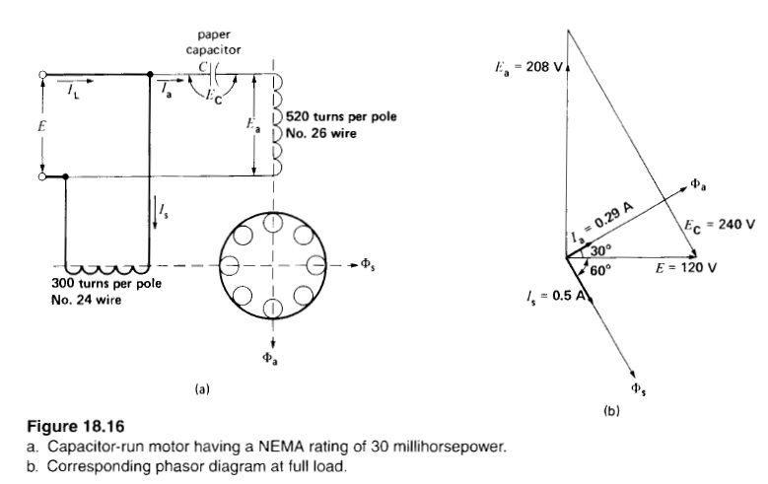
18.10 Capacitor-run motor

Slide 26
18.11 Reversing the direction of rotation
For reversing the direction of rotation, we either interchange the leads of auxiliary or main winding
For single-phase motor equipped with centrifugal switch: Direction can not be reversed while motor is running because only one winding is there while motor is running => If main winding leads are interchanged, motor will continue to run in the same direction
For capacitor-run motor: Direction can be reversed while motor is running because both windings are in circuit all the time
For small motors: Direction can be reversed using double-throw switch
Main and Auxiliary windings are identical
Position 1: A is main winding and motor turns in CW
Position 2: B is main winding and motor turns in CCW after becoming in halt condition

Slide 27
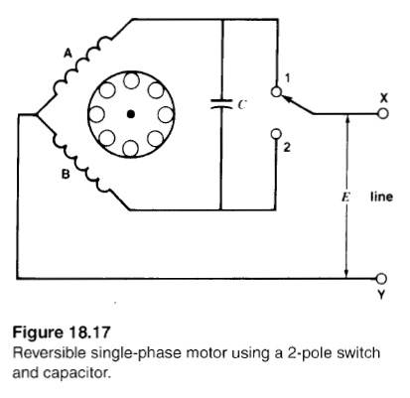
18.11 Reversing the direction of rotation

Slide 28
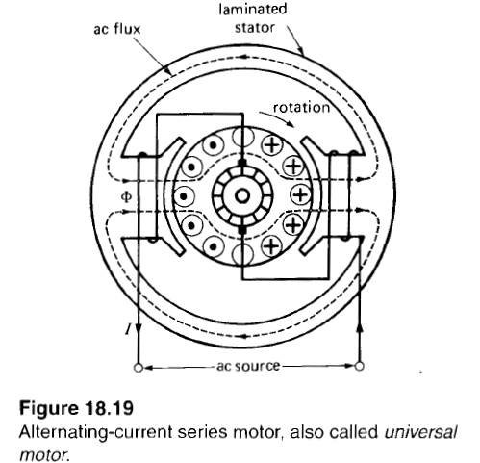
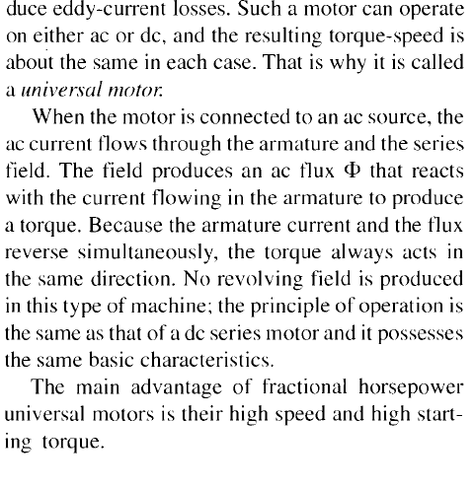
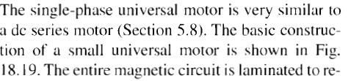
18.13 Universal Motors

Slide 29
Summary
Topics: 18.1-18.8,18.10, 18.11, 18.13
Examples: 18.1-18.2

